Slide 1
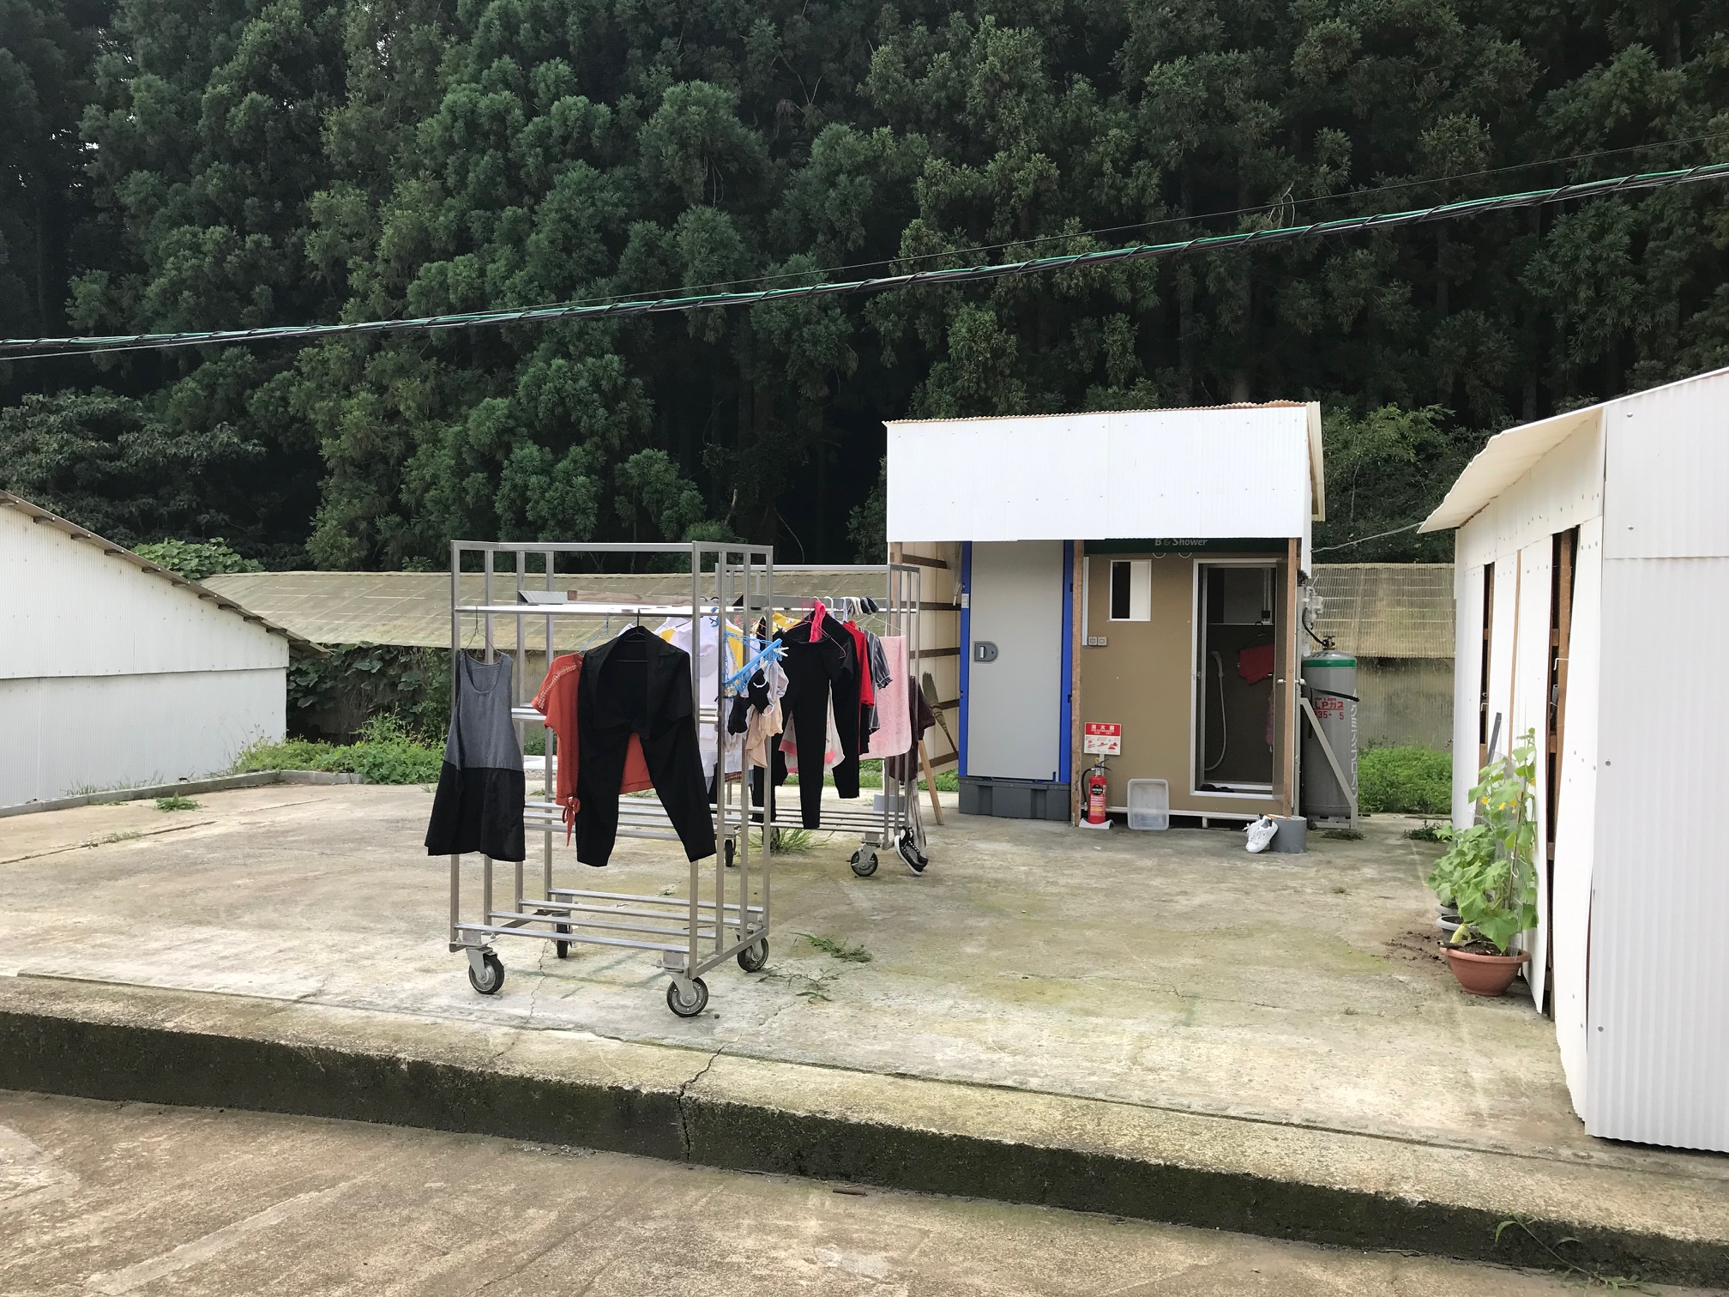
Stakeholders' views on foreign migrant workers in Japan's agriculture
Glenda S. Roberts, Ph.D.
Adjunct Senior Fellow, East-West Center robertsgs@waseda.jp
Noriko Fujita, Ph.D.
Tamagawa University
Noriko.fujita@lit.tamagawa.ac.jp
Daiwa Foundation
Seminar, 24 April
2025

Slide 2
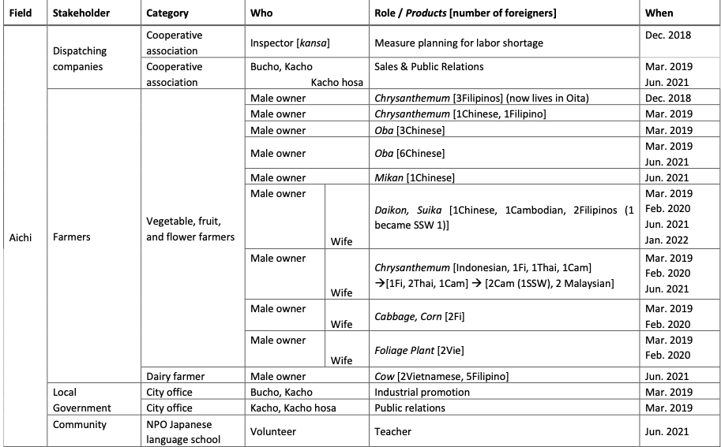
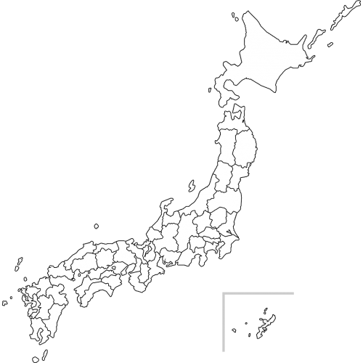
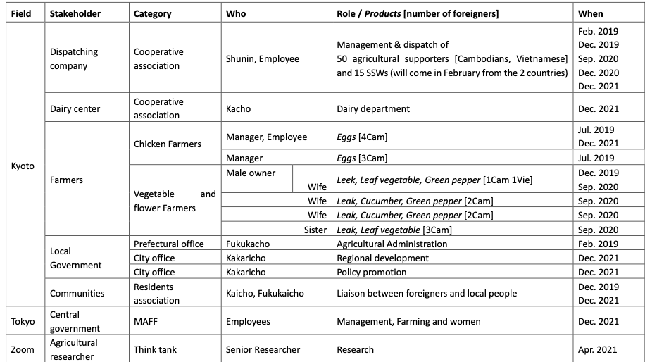
Methodology
Fieldwork Dec. 2018 – Sept. 2024
Minimum wage:
Aichi ¥986 / Kyoto ¥968 (2022)

Slide 3
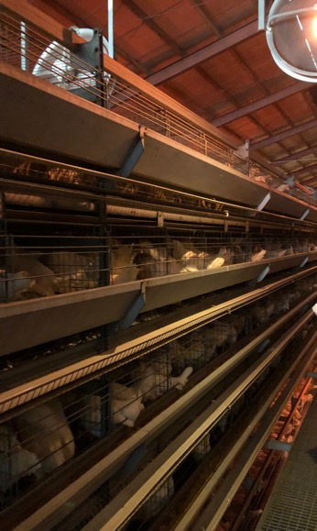
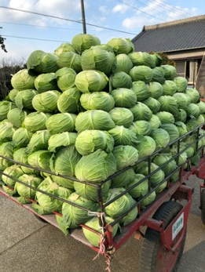
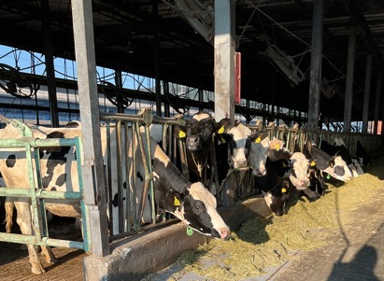
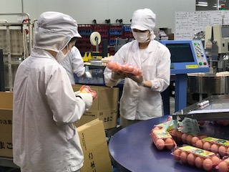
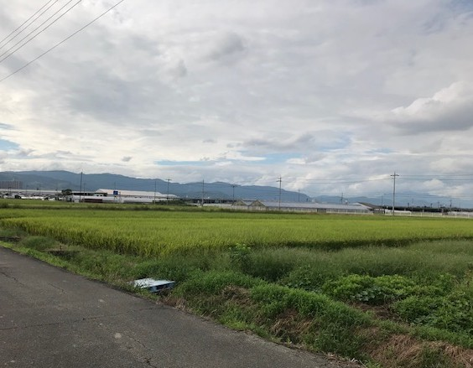
Diversified farming
hundred

Slide 4
Number of core persons mainly engaged in farming and their average age,12/24
Source: https//www.maff.go.jp/j/tokei/sihyo/data/08.html

Slide 5
Introduction
Labor Migration Schemes for Japan’s Agriculture
-Technical Interns and Training Program 1, 2, 3
-1 + 2 + 2 years
-Entry: experience?
-Minimum wage
-Direct Employment / No job change / No mobility
-Foreigners for Agricultural Support (only for tokku), 2014
-3 years
-Entry: TITP2
-Minimum wage or higher
-Dispatch / No job change / No mobility
-Specified Skilled Workers 1 + 2 since 2023)
-5 years (+ permanent +family reunion for SSW2)
-Entry: TITP2 or test (N4 + technical paper test)
-Higher than Minimum wage
-Direct Employment or Dispatch / Job change / Mobility
TITP
AG
Supporters
[tokutei katsudou]
(MOJ&MHLW 2022)
SSW
(MOJ 2023)

Slide 6
SSW by employment sector
https://www.moj.go.jp/isa/content/001428398.pdf

Slide 7
SSW by national origin
https://www.moj.go.jp/isa/content/001428398.pdf

Slide 8
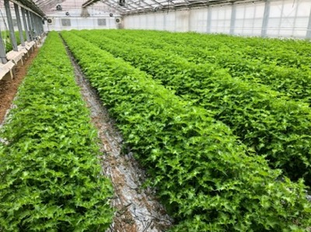
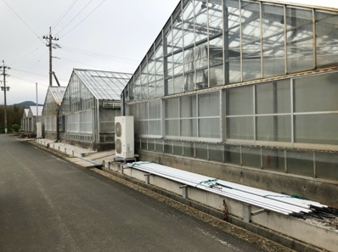
Research Questions
What meaning does this system change carry re Japan’s ‘opening up’ to low-skilled labor migration in the farming sector?
What sort of labor migration do farmers and other stakeholders envision, and is this sustainable?

Slide 9
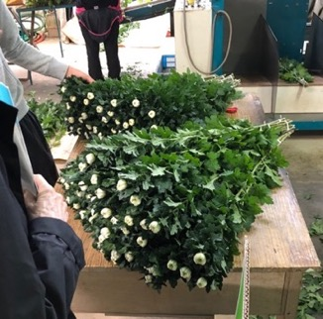
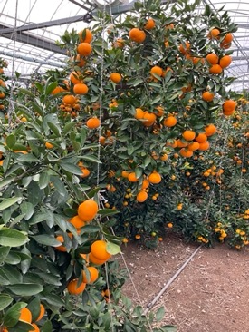
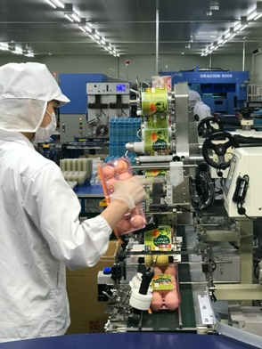
SSW... really skilled?
Cut flower farm
  a SSW1 came from a herb-leaf farm under COVID pandemic..
  but far from ‘rapid deployment force’.
Fruit farm
  a TITP worker is assigned for unskilled work.. which the old man and their sons count on
Higashi-san (veg & fruit farm)
  ’Skilled’ is tatemae... Necessary?
  ‘Special Work Visa’ makes more sense?

Slide 10
From TITP to ‘Employment for Skill Development’ (ESD)
In June 2024, the MOJ decided to scrap the troubled TITP system, in favor of a new system, 育成就労制度、 or the Employment for Skill Development system.
Purpose: to train and develop workers to possess the skills necessary for SSW1 status
The rhetoric of ‘intern’ and the guise of transfer of skills to developing countries are shed. ESD is clearly a labor-importing program.
Employer change “at will” with “certain conditions.” (ISA, 2025)
The program is now under construction; Will be rolled out in 2027.
The farmers got what they wanted- a bona-fide worker program. But SSW is on top of it, leading us to wonder: do farmers want workers to stay on for so long?

Slide 11
SSW... not temporary visa?
Martin Ruhs (2015) The Price of Rights: Regulating International Labor Migration
  Temporary Migration Program... trade offs between
    openness to unskilled labor migration in receiving country
    extent of rights given to migrants
      pragmatic for restricting some rights
      (permanent residency, employer choice, job mobility..)
ESD + SSW1 = 8 years... too long?
Marriage window, family separation… workers tend to be either unmarried or those with children left behind.

Slide 12
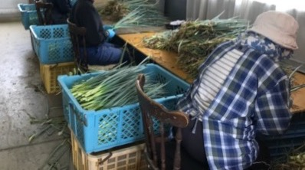
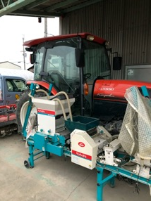
Discussion
What does ‘skill’ mean in agriculture?
One farmer told us, “Taking everything into account, I wonder who is coming here for learning and transferring skills? Must be very few! [laughs]”
It became clear to us that in agriculture, ‘skill’ that farmers want means a facility at basic techniques for production of farm products, learned through OJT, relatively quickly.
Most farmers are not interested in paying more for extra ‘skills,’ although they might entertain the thought if some workers had driving and data-inputting skills.

Slide 13
Disjuncture with the Family Farming model of labor management
“Wet” vs. “Dry” management of workers
Workers treated as ‘ko,’ child
Workers live on the property, farm household is responsible for workers’ livelihood support
“Eventually, there was a trend from technical training to Specified Skilled worker. Technical internship was not a ‘dry’ employee, but more like a ‘family’ in the case of farmers. When [trainees or SSW workers] got married or had children, it became an event in [one’s] family. It’s hard to simply say, “Oh, really?”

Slide 14
Village Japan:
The fear of causing ‘meiwaku’
Farmer C told us:
“If they brought their children, it would cause inconvenience, so I would not dare to choose that worker [to work on my farm].”
Farmer C fears that the farmers, who have ultimate responsibility for workers, would be the first ones to have to respond if city services proved inadequate to stem local criticism
The local official disagreed.
Famers’ concerns centered on effects on the city hall, the schools and the children’s association.
A previous interviewee also noted concern that foreign families would probably not desire to share in the myriad village activities surrounding rites and rituals (funerals, festivals, etc).

Slide 15
To Conclude:
How could SSW2 be made successful in rural areas?
If SSW2 were to be successful in agriculture (or in any other field), the national government would need to step in to invest a great deal more than it currently provides:
    --for systematic language training (including for spouses)
    --for housing (public housing or empty house renovations, for instance)
    --for children’s public educational programs and teacher training; legal changes to ensure that all children attend school.
    --for activities to bring newcomers and their Japanese neighbors together to become accustomed to each other.
    --public education to be inclusive and appreciative of the diverse others who make up Japanese society.

Slide 16
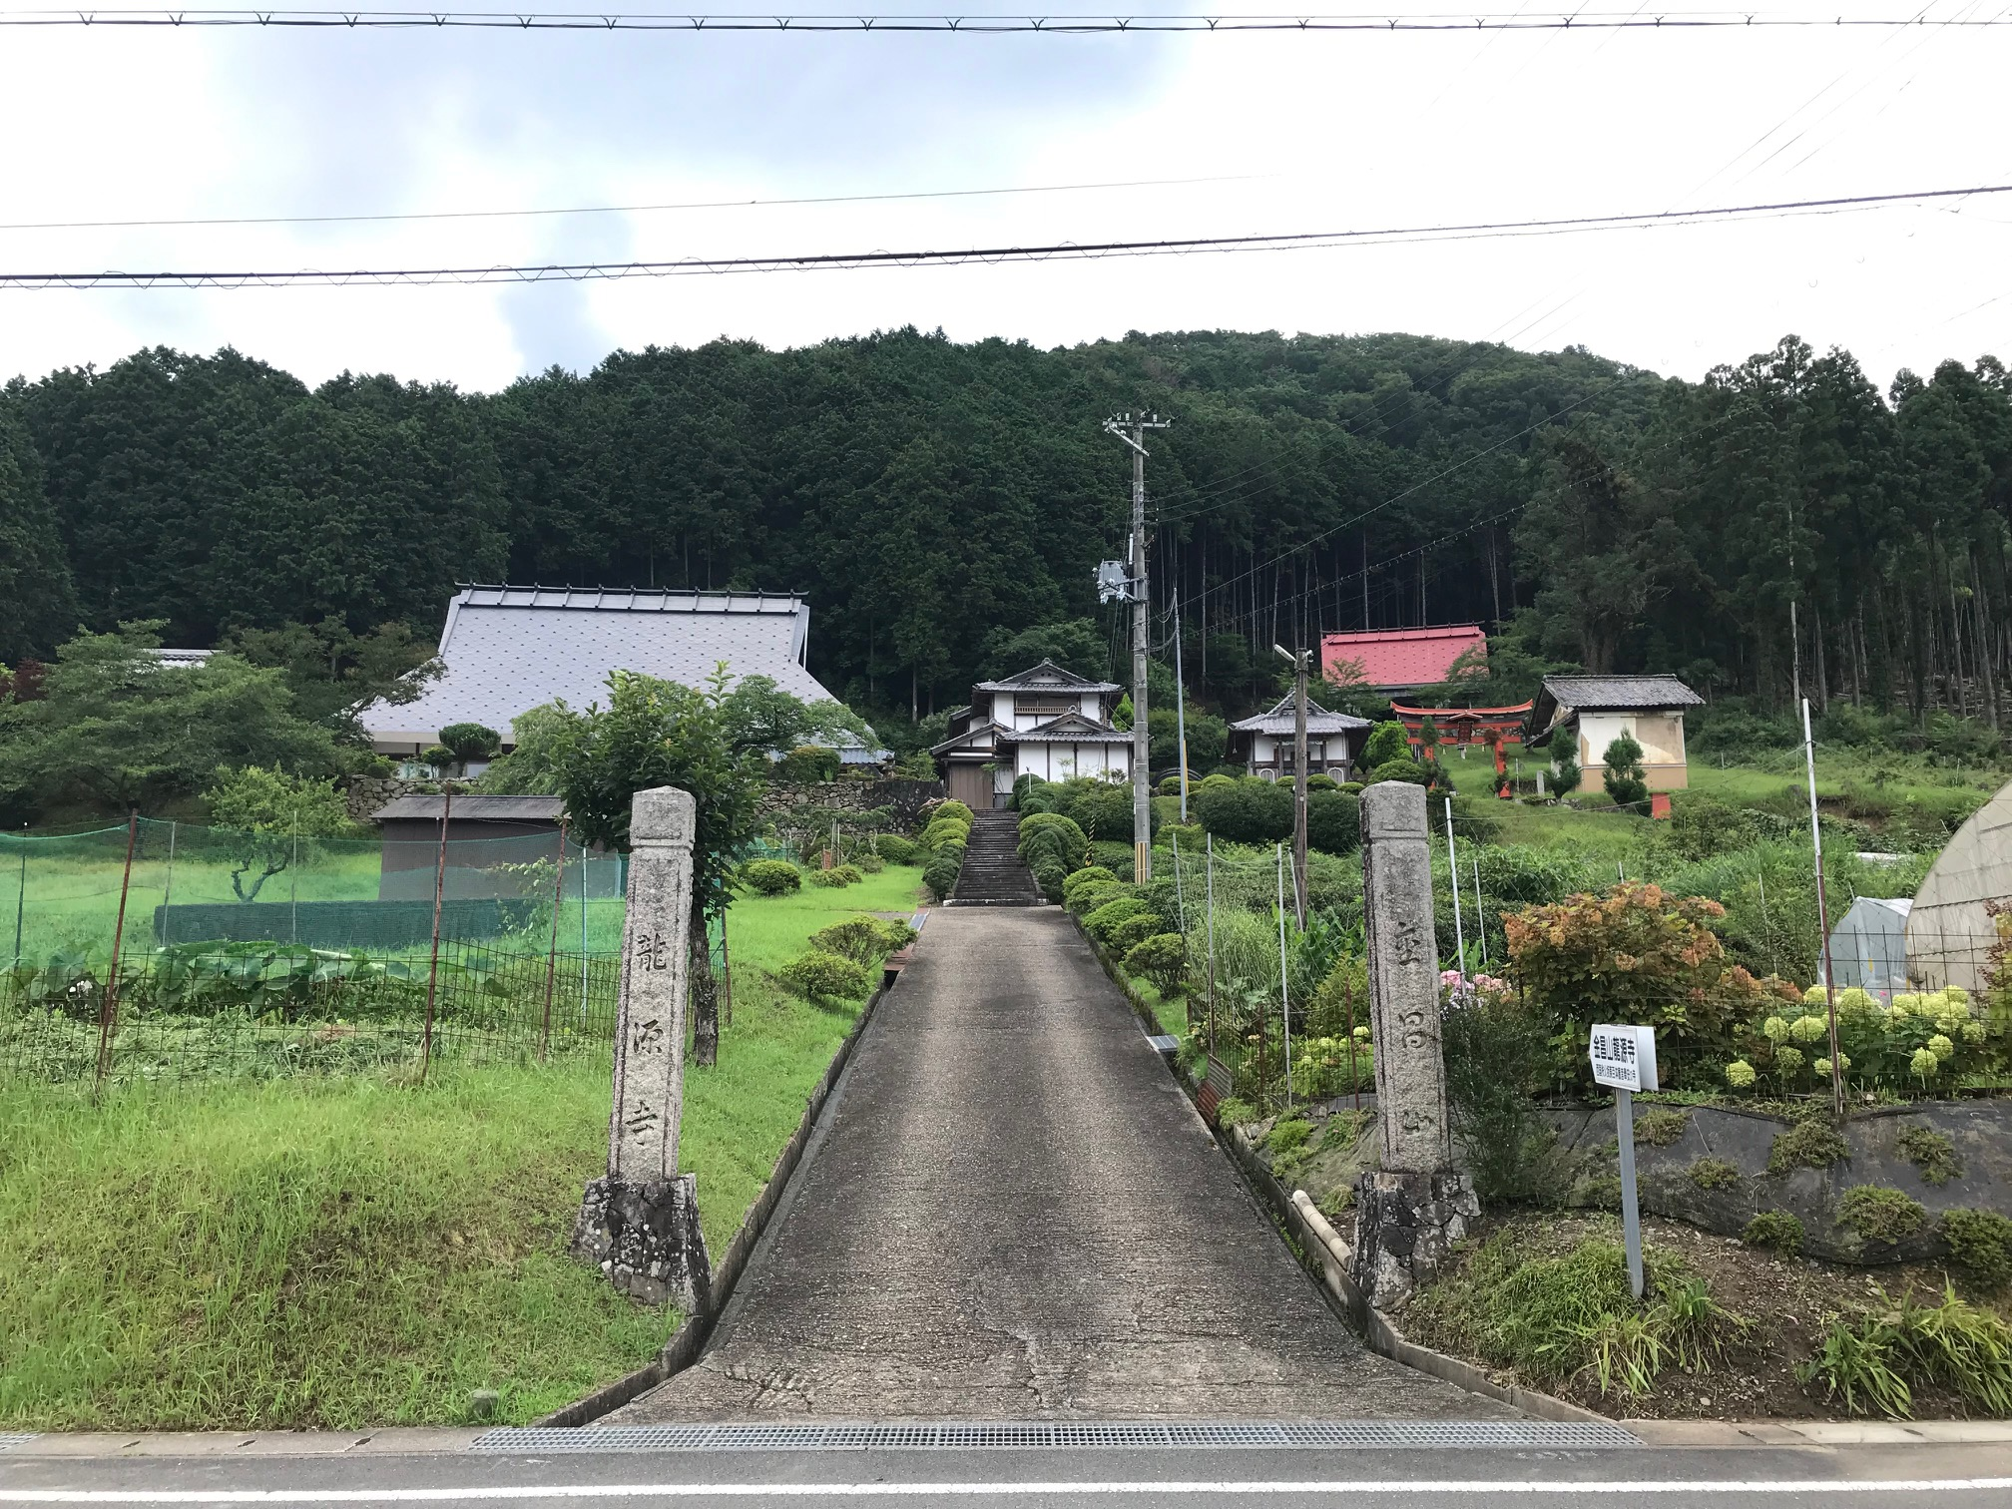
Thank you very much for your kind attention!

Slide 17
Selected References
Asis, Maruja M. B. and Battistella Graziano. 2018. ‘Irregular Migration in Asia: Are New Solutions in sight?’ In Routledge Handbook of Asian Migrations, eds. Gracia Liu-Farrer and Brenda S. A. Yeoh. London and New York: Routledge: 277-98.
Ameeriar, Lalarie. 2017. Downwardly Global: Women, Work and Citizenship in the Pakistani Diaspora. Durham, NC: Duke University Press.
Baas, Michael. 2018. ‘Temporary Labour Migration.’ In Routledge Handbook of Asian Migrations, eds. Gracia Liu-Farrer and Brenda S. A. Yeoh. London and New York: Routledge: 51-63.
Horiguchi, Kenji. 2017. ‘Nōgyō ni miru ginōjisshūsei no yakuwari to sono kakudai: Jukuren wo kakutoku shinagara keiei no shitsuteki jūjitsu ni kōken suru gaikokujin rōdōryoku (TITP Workers’ Roles and their Expansion in Agriculture: Foreign Laborers who Obtain Skills and Contribute to Qualitative Enrichment of Management).’ In Nihon no rōdō shijō no kaihō no genkyō to kadai: Nōgyō ni okeru gaikokujin ginō jisshū no omomi (Opening of Japan’s Labor Market and its Problems: Importance of TITP Workers in Agriculture), ed. Kenji Horiguchi. Tokyo: Tsukuba Shobo: 14-30.
Hamaguchi, Keiichiro. 2019. ‘How Have Japanese Policies Changed in Accepting Foreign Workers?’ Japan Labor Issues 3 (14): 2-7. The Japan Institute for Labour Policy and Training.
Ishida, Kazuki. 2017. ‘Kokka senryaku tokubetsukuiki ni okeru nōgyō shien gaikokujin ukeire jigyō no gaiyō (A Summary of Agricultural Supporting Foreigners Accepting Program at National Strategic Zones).’ Nōrin kinyū 2017 (11): 626-45.
Kalicki, Konrad. 2021. ‘Toward Liberal Immigration Control: The Case of Japan.’ Asian Survey 61 (5): 854-82.
-----. 2022. ‘Fearful States: The Migration-Security Nexus in Northeast Asia.’ The Pacific Review 35 (1): 59-89.
Kamibayashi, Chieko. 2015. Gaikokujin rōdōsha ukeire to nihon shakai: Ginōjisshuu seido no tenkai to jirenma (Accepting Foreign Workers in Japanese Society: The Dilemma of a Temporary Immigrants Program). Tokyo: Tokyo daigaku shuppankai.
Keidanren. 2022. ‘Innovating Migration Policies: 2030nen ni muketa gaikokujin seisaku no arikata’ Ippan shadan houjin nihon keizai dantai rengokai. https://www.keidanren.or.jp/policy/2022/016.html (accessed 28 Mar 2023).
Kumagai, Sonoko. 2002. ‘Nōgyō ni okeru kazoku kankei to keiei, rōdō (Family Relations, Management, and Labor in Agriculture).’ In Kazoku to shokugyō: Kyōgō to chōsei (Family and Work: Competition and Adjustment), ed. Kunio Ishihara. Kyoto: Minerva: 182-200.
-----. 2006. ‘Gendai nihon no kazoku nōgyō keiei (Family Farm Management in Contemporary Japan).’ Shukutoku daigaku sōgō fukushi gakubu kenkyū kiyō 40: 67-80.
Kurochkina, Ksenia, 2020. Resettlement of Young People to the Countryside in Japan: Alternative Life Choices in a Changing Society. Waseda University Doctoral Dissertation.
LeBaron von Baeyer, Sarah. 2020. Living Transnationally between Japan and Brazil: Routes beyond Roots. Lanham, Maryland, Lexington Books.
Lessard-Phillips, Laurence, Glenda S. Roberts, and Jenny Phillimore. 2019. ‘Policy and Politics of Migration Post 1945.’ In IRiS Working Paper Series (34). University of Birmingham.
Liu-Farrer, Gracia. 2020a. ‘Japan and Immigration: Looking Beyond the Tokyo Olympics’ The Asia-Pacific Journal: Japan Focus 18 (4) 5: 1-8.
-----. 2020b. Immigrant Japan: Mobility and Belonging in an Ethno-nationalist Society. Ithaca, NY: Cornell University Press.
Liu-Farrer, Gracia, Brenda S. Yeoh, and Michiel Baas. 2021. ‘Social Construction of Skill: An Analytical Approach Toward the Question of Skill in Cross-border Labour Mobilities.’ Journal of Ethnic and Migration Studies 47 (10): 2237-51.
Lollini, Niccolo. 2021. Becoming a Farmer in Japan. Oxford University Doctoral Dissertation.
MAFF. 2019. ‘Nōgyō no gaikokujin ginō jishuusei ukeire no yūryō jirei (Good Cases of Accepting TITP Foreigners in Farming).’ https://www.maff.go.jp/j/keiei/foreigner/attach/pdf/index-78.pdf (accessed 25 Sep 2022).
-----. 2021. ‘Nōgyō rōdōryoku ni kansuru tōkei: Kikanteki nōgyō jūjisha (Kojin keieitai) (Statistics on Agricultural Labor Force: People who Do Farming as Main Job (Individual Enterprise)).’ https://www.maff.go.jp/j/tokei/sihyo/data/08.html (accessed 25 Sep 2022).
-----. 2022. Shokuryō, nōgyō, nōson hakusho (White Paper on Food, Agriculture, and Farming Villages). https://www.maff.go.jp/j/wpaper/w_maff/r3/zenbun.html (accessed 25 Sep 2022).
Meng, Liang. 2014. Seasonal Labour Migration of Chinese Agricultural Workers to Kawakami Village: Migrant Realities, Negotiations, and a Collaborative Power Network.. Jesus College, Department of East-Asian Studies, University of Cambridge Doctoral Dissertation, 2014.
Mills, Mary Beth. 1999. Thai Women in the Global Labour Force: Consuming Desires, Contested Selves. New Brunswick, NJ: Rutgers University Press.
MHLW. 2022. ‘“Hatarakikata kaikaku” no jitsugen ni mukete (Toward the Achievement of Working Style Reform).’ https://www.mhlw.go.jp/stf/seisakunitsuite/bunya/0000148322.html (accessed 25 Sep 2022).
MLIT. 2019. ‘Aratana gaikokujinzaino ukeire ni tsuite (About the Acceptance of New Foreign Human Resources.’ http://www.thr.mlit.go.jp/bumon/b06111/kenseibup/plan_build/pdf_0810/190507_siryou1.pdf (accessed 28 Mar 2023).
MOJ. 2019. ‘Tokutei ginō rīfuretto (Leaflet for SSW).’ https://www.moj.go.jp/isa/content/930004040.pdf (accessed 25 Sep 2022)
-----. 2021. ‘Immigration Control and Residency Management: Part I: Immigration Control and Residency Management in Recent Years.’ https://www.moj.go.jp/isa/content/001361699.pdf (accessed 25 Sep 2022).
-----. 2022. ‘Tokutei ginō ichigou zairyū gaikokujinsū. Reiwa 4nen 6gatumatsu genzai (Number of SSW1 as of June 2022).’ https://www.moj.go.jp/isa/policies/ssw/nyuukokukanri07_00215.html (accessed 28 Mar 2023).
-----. 2023a. ‘Tokutei ginō ichigou zairyū gaikokujinsū. Reiwa 4nen 12gatsumatsu genzai (Number of SSW1 as of December 2022).’ https://www.moj.go.jp/isa/content/001391804.pdf (accessed 28 Mar 2023).
-----. 2023b. ‘Ginō jisshū seudo oyobi tokutei ginō seido noarikata ni kansuru yūshikisha kaigi (dai 4 kai)’ (The 4th Advisory Committee of Deliberating TITP and SSW systems) https://www.moj.go.jp/isa/policies/policies/03_00061.html (accessed 28 Mar 2023).
MOJ & MHLW. 2022. ‘Gaikokujin ginōjisshuu seido ni tsuite (About TITP System).’ https://www.moj.go.jp/isa/content/930005177.pdf (accessed 25 Sep 2022).
Nikaido, Yuko. 2019. ‘Gaikokujin ginōjisshū seido ni yoru kokusaikouken ni muketa kadai: Vetonamu ni okeru nōgyō bunya no gijutsu iten no kanousei (Issues for International Contributions by TITP Foreigners: Possibilities of Technical Skills Transfer to Agricultural Fields in Vietnam).’ Nishinihon shakai gakkai nenpō (17): 47-61.
Oishi, Nana. 2021. ‘Skilled or Unskilled?: The Reconfiguration of Migration Policies in Japan.’ Journal of Ethnic and Migration Studies 47 (10): 2252-69.
Roberts, Glenda S. 1996. ‘Between Policy and Practice: Silver Human Resource Centers as Viewed from the Inside.’ Journal of Aging and Social Policy 8 (2-3): 115-32. Simultaneously published in Public Policy and the Old Age Revolution in Japan, eds Scott A. Bass, Robert Morris, and Masaato Oka. Public Policy and the Old Age Revolution in Japan. New York and London: The Haworth Press: 115-32.
-----. 2018. ‘An Immigration Policy by Any Other Name: Semantics of Immigration to Japan.’ Social Science Japan Journal 21 (1): 89–102.
Roth, Joshua. 2002. Brokered Homeland: Japanese Brazilian Migrants in Japan. Ithaca, NY: Cornell University Press.
Ruhs, Martin. 2015. The Price of Rights: Regulating International Labor Migration. Princeton: Princeton University Press.
Sakamoto, Keita. 2020. ‘Genba hōkoku, ijū rōdōsha no seikatsu to kenri no tameni: Rōdō undo kara mita genjō to kadai (Field Report, for Lives and Rights for Migrant Workers: Situations and Issues Seen from Labor Movement).’ Nihon rōdō shakai gakkai nenpō 31: 86-104.
Sato, Shinobu. 2021. Nihon no gaikokujin rōdōsha ukeire seisaku: Jinzai ikusei shikō gata (Policies of Accepting Foreign Workers in Japan: Personnel Cultivation Orientation Model). Kyoto: Nakanishiya shuppan.
Shikata, Hisanori. 2021. ‘Gaikokujin rōdōsha ni kansuru nyūkan hōsei no hensen (Change of Immigration Laws on Foreign Workers).’ In Nihon de hataraku: Gaikokujin rōdōsha no shiten kara (Working in Japan: From Viewpoint of Foreign Workers), eds. Tairō Ito and Hironori Sai. Kyoto: Shoraisha: 67-96.
Shore, Cris, Susan Wright and Davide Pero. 2011. Policy Worlds: Anthropology and the Analysis of Contemporary Power. New York, Oxford: Berghahn Books.
Sunai, Naoko. 2019. ‘“Shissō” to yobuna: ginōjishūsei no rejisutansu (Don’t Call it “Disappearance”: Resistance of TITP Workers).’ Gendai shiso 04 Shin imin jidai. Seidosha.
Suzuki, Eriko. 2020. ‘“Ichioku sōkatsuyaku shakai” no haigo de susumu “gaikoku jinzai no katsuyō”: Naniga kare/kanojora no “katsuyaku” wo habamunoka? (Advancing the “Utilization of Foreign Human Resources” under the “Society to Promote Active Participation of All Japan 100 Million Citizens”).’ Shakai seisaku 11 (3): 29-41.
Suzuki, Nobuhiro. 2022. ‘No Independence without Self-Sufficiency: Japan’s Pressing Need to Boost Food Security.’ https://www.nippon.com/en/japan-topics/g02082/# (accessed 26 April 2023).
Strausz, Michael. 2019. Help (Not) Wanted: Immigration Politics in Japan. Albany: SUNY Press.
Tian, Yunchen. 2018. ‘Workers by Any Other Name: Comparing Co-ethnics and ‘Interns’ as Labour Migrants to Japan.’ Journal of Ethnic and Migration Studies, 45 (9): 1496-514.
Torii, Ippei. 2020. ‘Sekai ga “Dorei rōdō” to miru ginōjisshū seido no kyokō: “Imin taikoku” nihon, watashi no teigen 5 (Fiction of TITP System that the World Sees as Slave Labor: Full of Migrants Japan, My Proposal.).’ The Globe, 20 December 2020. https://globe.asahi.com/article/14027921?fbclid=IwAR1bQTgOgq5FZJPB5B-7S1PhUkH1MzFCpVXGYGvj0ymH_BVtpPrKoshrKeE (accessed 25 Sep 2022)
Tsubota, Kunio. 2018. ‘Nōgyō no gaikokujinzai ukeire no kadai (1) (Issues in Accepting Foreign Human Resources in Agriculture).’ Nihon nōgyō kenkyūjo kenkyū hōkoku “Nōgyō kennkyū” 31: 135-70.
Yoshida, Mai. 2021. Onko to jūzokuteki hōsetsu: Gaikokujin ginōjisshuu seido ni okeru rōmukanri (Debt of Gratitude and Subordinate Inclusion: Labor Management in the Technical Intern Training Program). Shakaigaku hyoron 71 (4): 671-87.

Slide 18
Economic security vs fears for personal/internal security
  “If you think of all the problems, you end up saying it’s better not to (bring in immigrants), but in order for Japan to keep growing, if we had no immigrants, we’d certainly not grow.” @ farmers’ meeting in December 2018
  Increasing presence of foreign residents is unsettling to some Japanese. According to one young man who had inherited his father’s chrysanthemum business, however, this problem will surely abate when the elders pass away.

Slide 19
In the Construction Field…
In the Construction field, the notion of “skill” is quite different.
Workers are being taught discrete skills necessary for their trade, and a ‘skill-up’ program is being introduced to ensure that workers can gain mobility in the profession if they desire it.
The employers that Roberts talked to were eager to have their workers learn these skills and move up in the system. One employer noted that many of his foreign employees wanted to stay on for SSW2 status, and were eager to gain the status, which requires management skill, language facility, as well as particular manual skills.
Unlike most of the farmers we talked with, the construction employers Roberts met with were enthusiastic about having these workers stay for the long-term—perhaps because the skills are more difficult to learn and it is more dangerous to have continual turnover, but also because their businesses were in the city, where there is more anonymity, less likelihood of locals complaining about the foreigners, easier for foreigners themselves to ‘have a life’ outside of work. Moreover, construction business owners did not sound as anxious about the costs of labor as farmers were.

